Slide 1
Social Theory
Functionalism, Conflict Theory, Feminist Theory

Slide 2

Social Theories
A Theory is a way of explaining a phenomena
Tools to help us understand why something is the way it is
Social Theories
Functionalism
Conflict Theory
Feminist Theory

Slide 3
Functionalism
Society is a complex system whose parts work together to promote solidarity and stability
Looks at role of different parts of society (social structure, norms, customs, traditions, institutions)
Each has a function that helps society to succeed
Example: Police maintain order by enforcing laws
Social Structure
Pattern of social relationship in a society
Relationship of groups to each other
Different groups with different roles and purposes

Slide 4
Organ Analogy
Society is like a biological organism
Organs are like institutions
Each organ has a function that allows the organism to live
Examines institutions: “What does it do to allow society to function?”
Interdependent
Homeostasis
Example
Government is the brain
It controls society

Slide 5
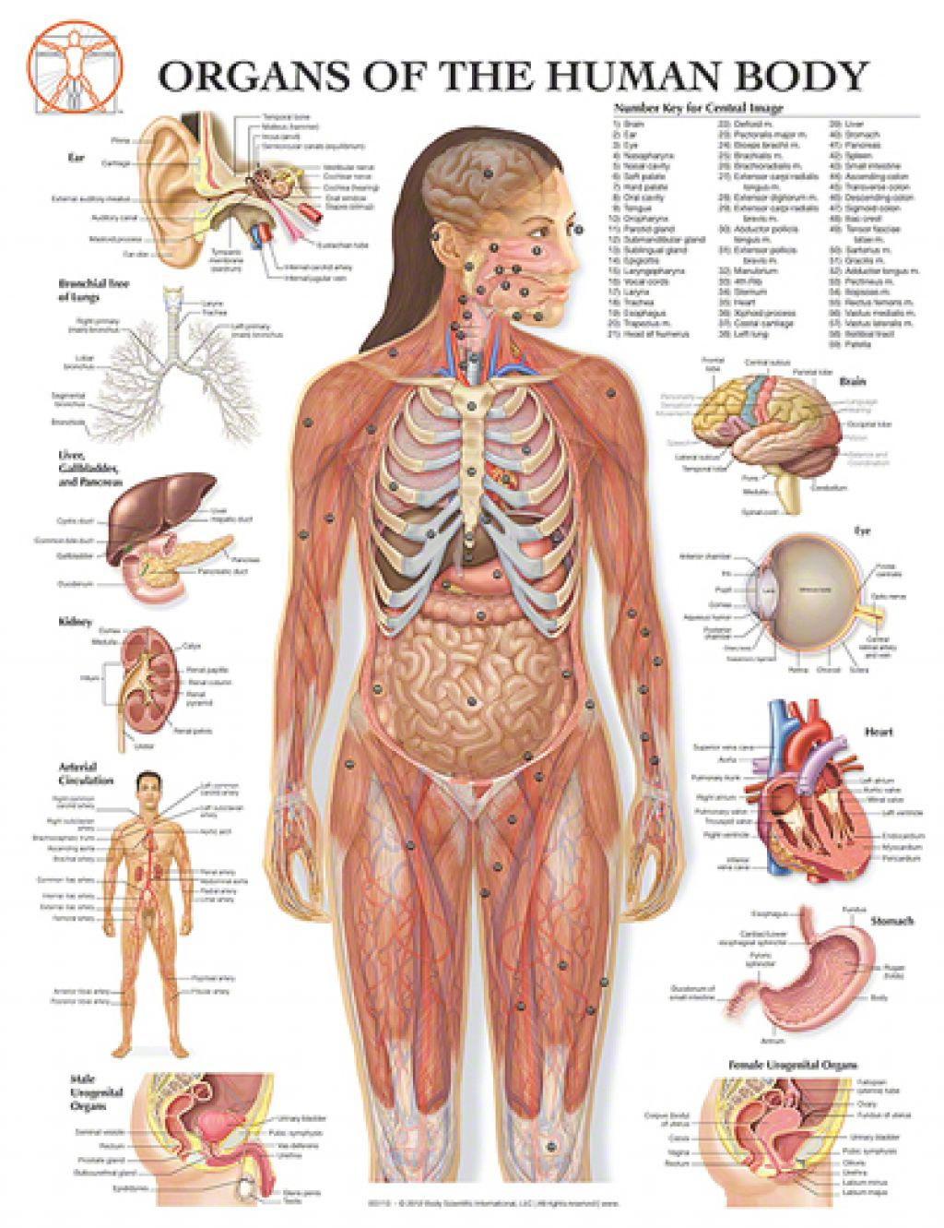
Exercise
List 5 different institutions
Give their equivalent organs
Describe their function

Slide 6
Vocabulary
Theory – a way of explaining a phenomena
Function – the action for which a person or thing is used for (what it does)
Complex – complicated or interrelated parts
(antonym of simple)

